Slide 1
2017 Performance Analysis South Texas

Slide 2
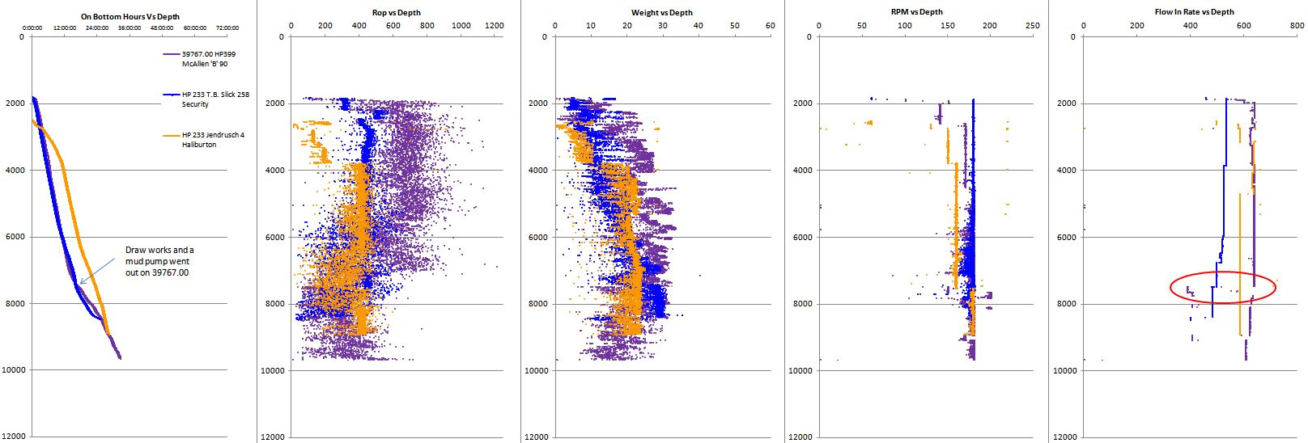
39767.00 Run 1
McAllen B-90 H&P399

Slide 3
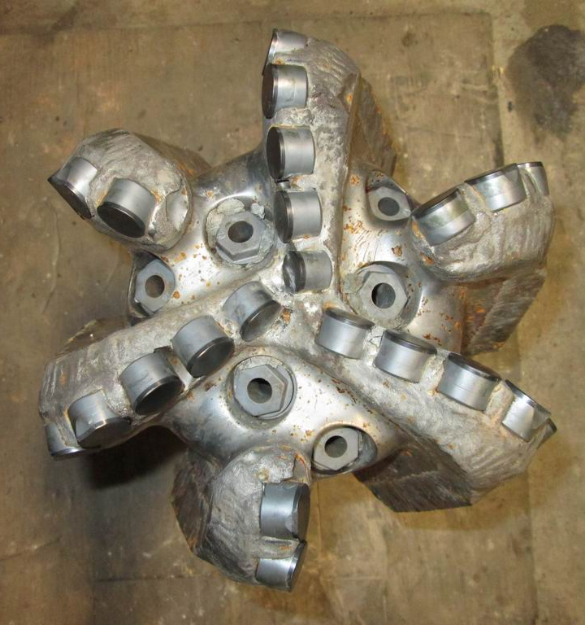
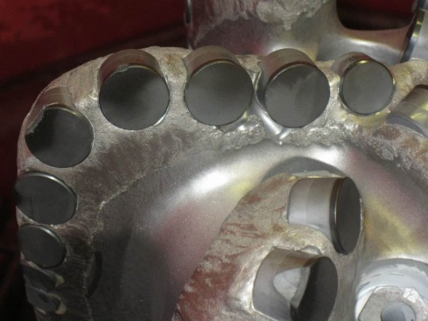
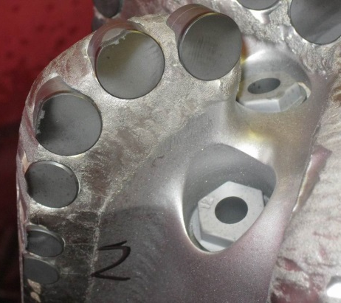
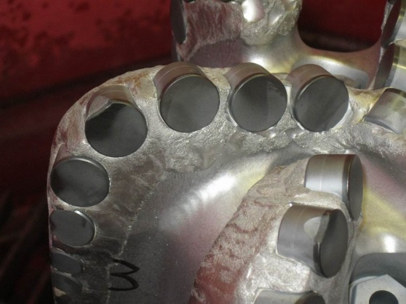
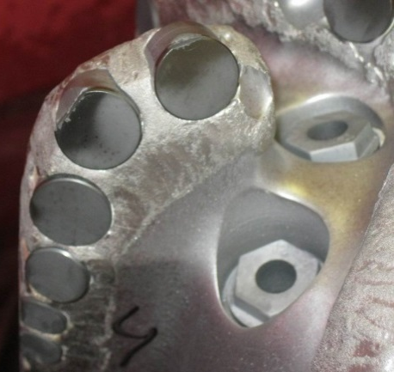
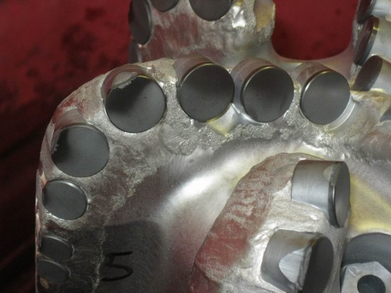
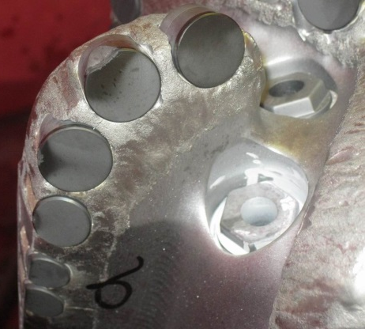
McAllen B-90 Run #1

Slide 4
Summary McAllenB-90 H&P399 Run #1
Very fast, competitive ROP
Draw works and a mud pump went out causing the drop in ROP at around 7500’
Bit made TD
Good dull condition

Slide 5
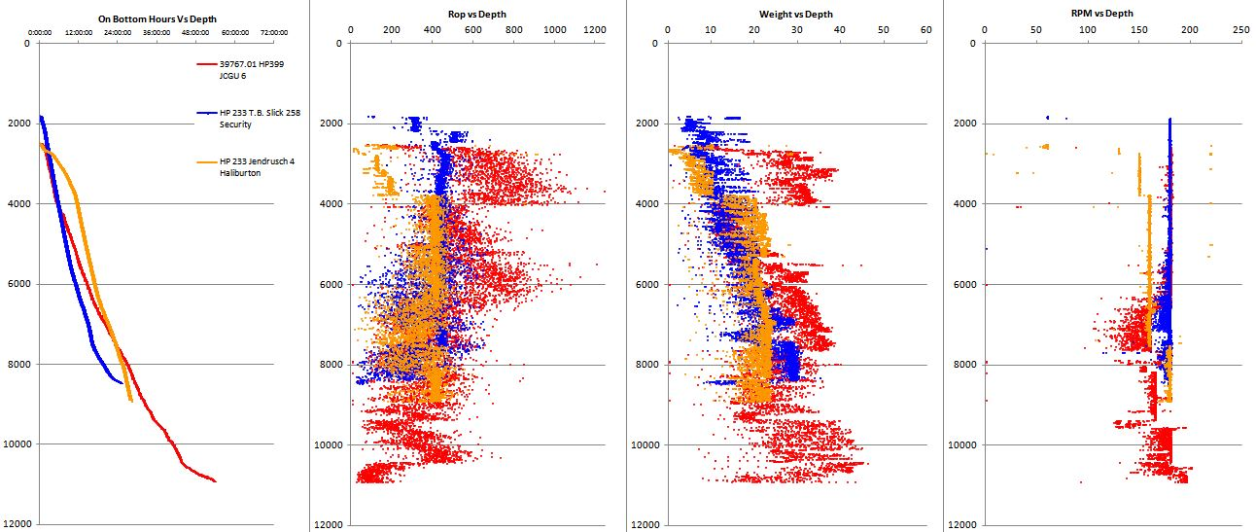
39767.01 Run 2
JCYP 6 H&P399

Slide 6
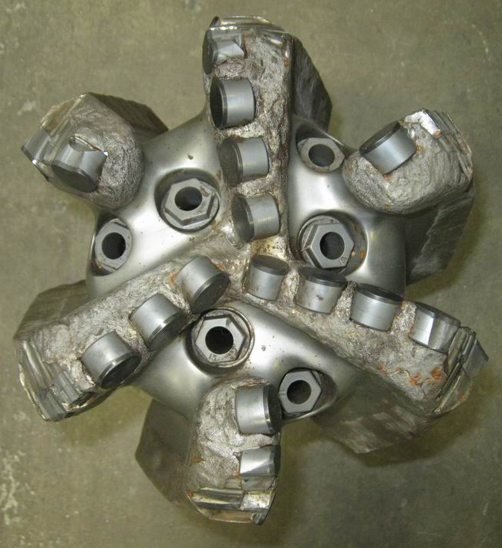
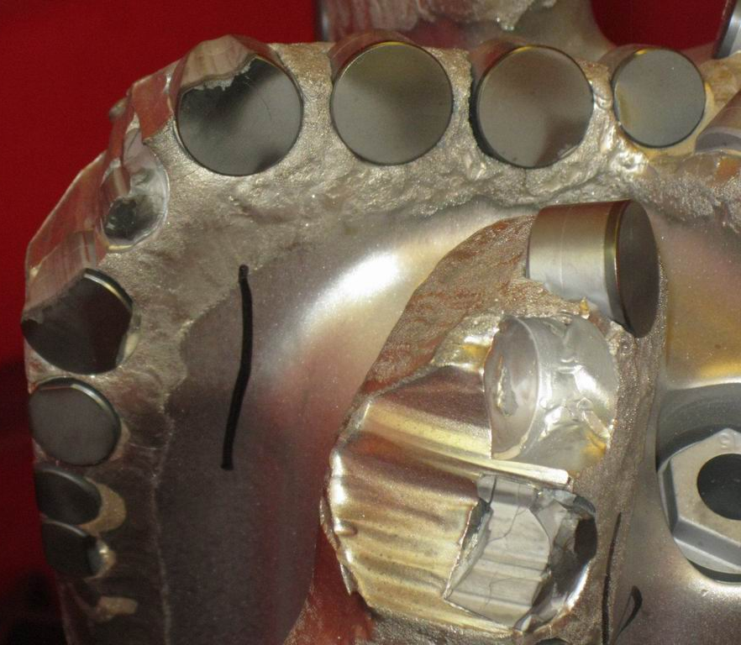
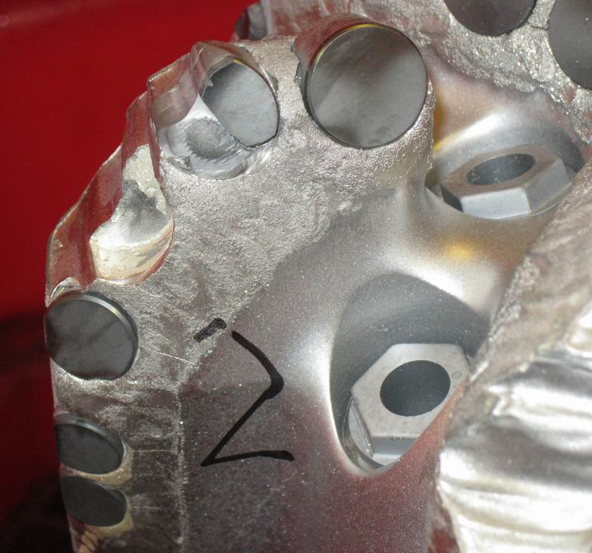
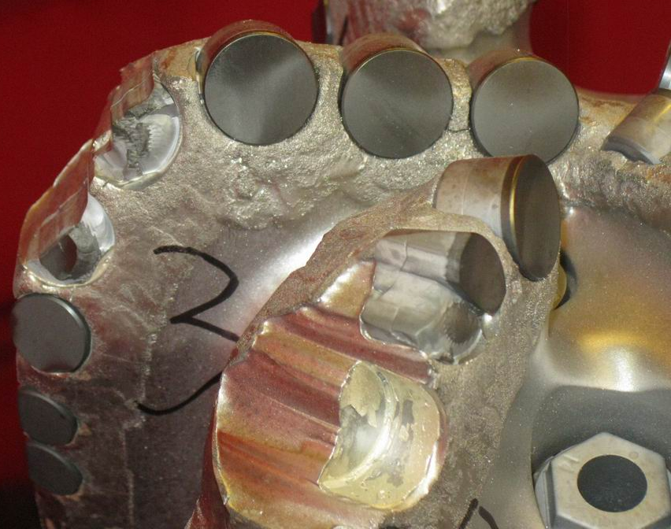
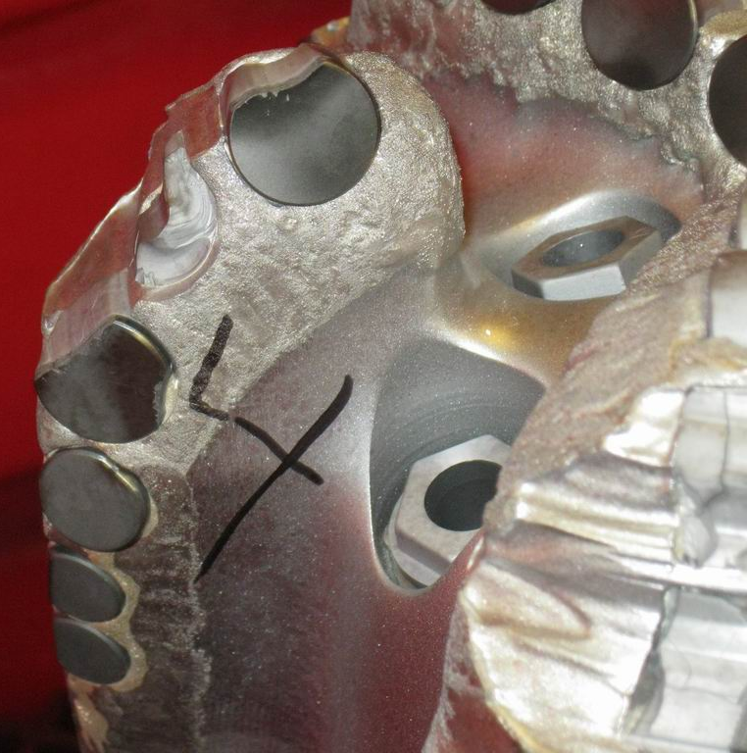
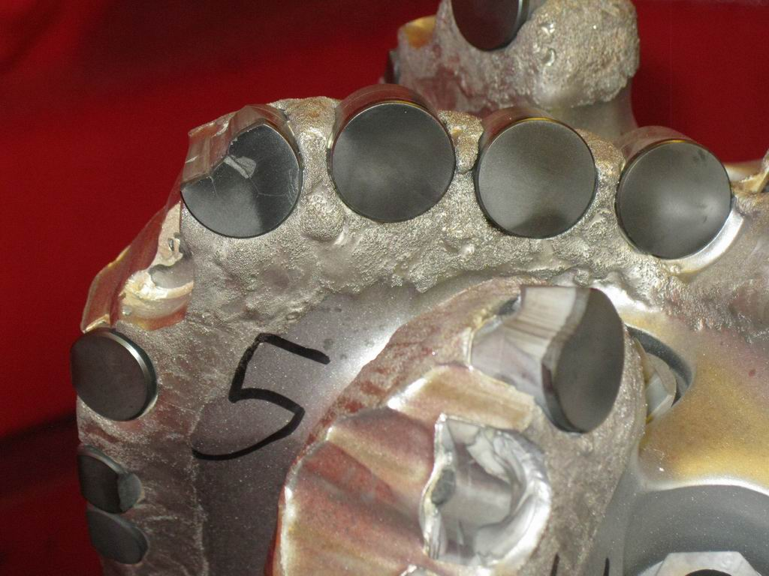
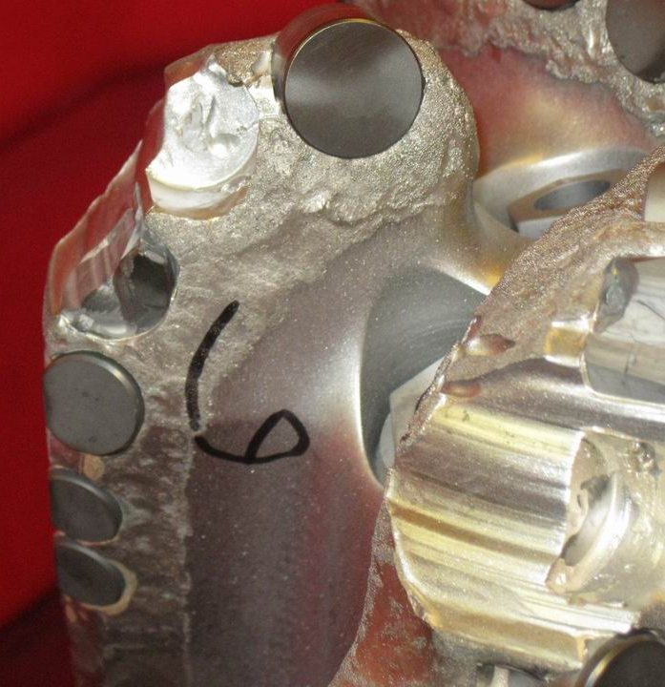
JCYP 6 H&P399 Run #2

Slide 7
Summary JCYP 6 H&P
Run #2
Very fast, competitive ROP
Lost cutters led to terrible dull condition
Bit made TD

Slide 8
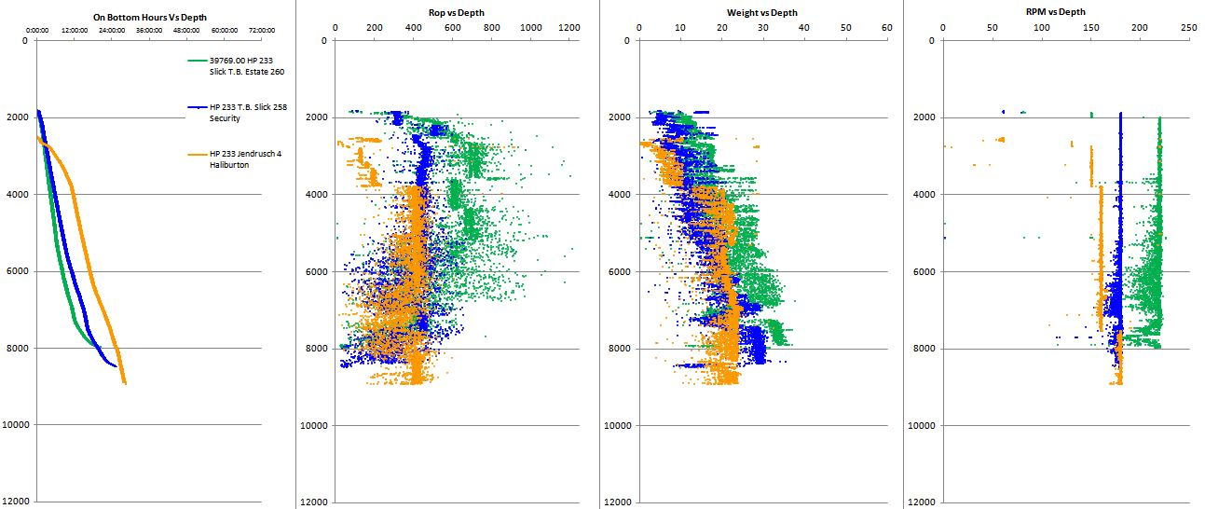
39769.00 Run 3
Slick Ranch 260 H&P233

Slide 9
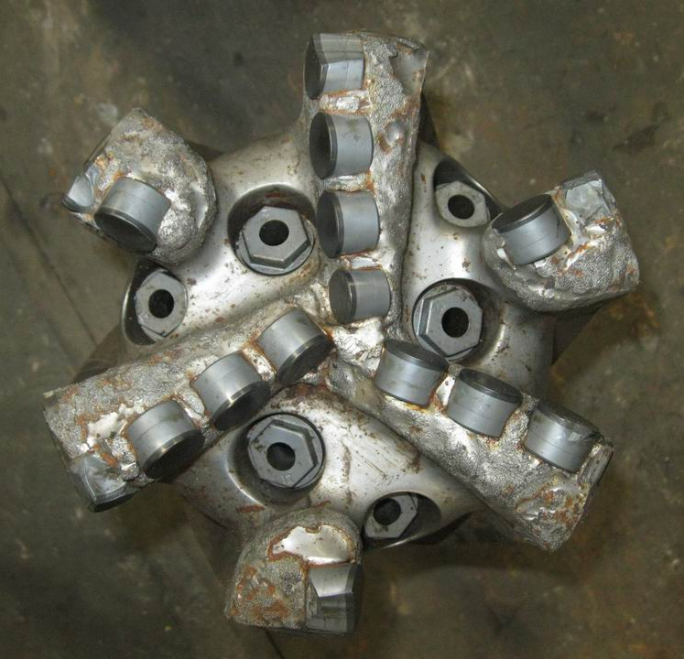
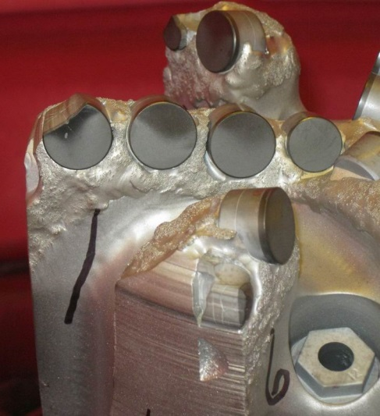
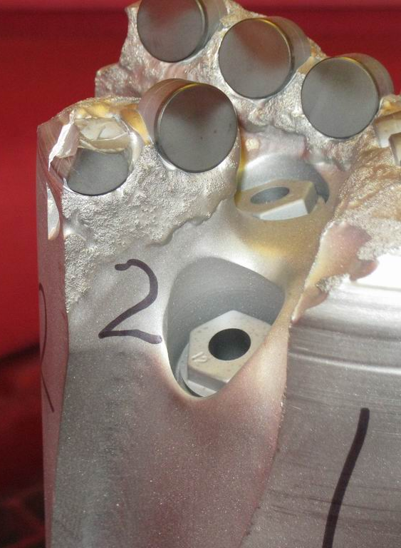
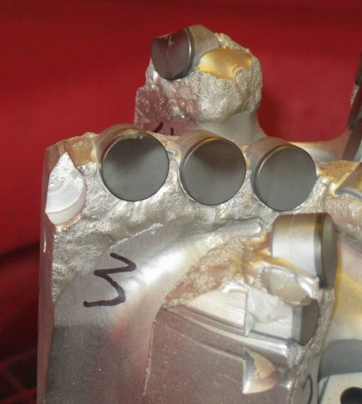
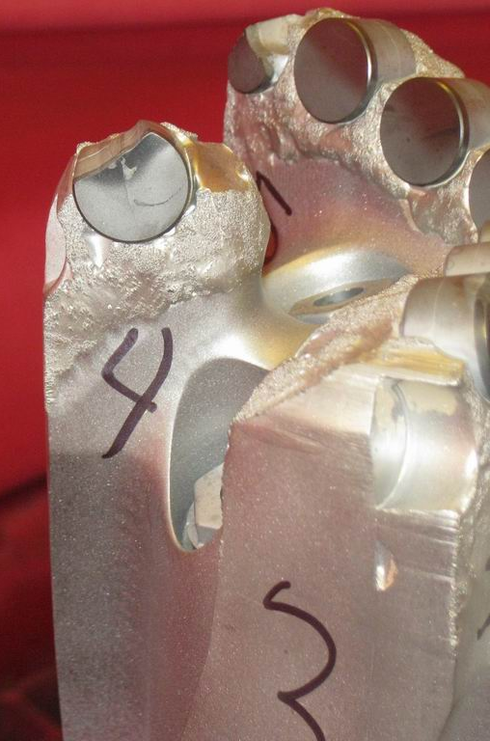
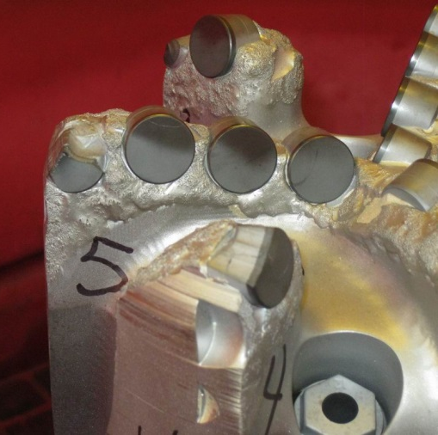
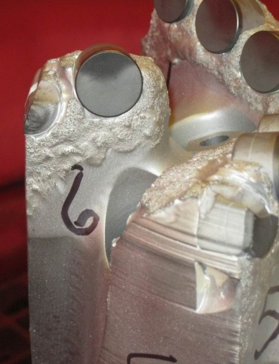
Slick Ranch 260 Run #3

Slide 10
Summary Slick Ranch 260 H&P 233 Run #3
Very fast, competitive ROP
Bit came back as a DBR (1” under gauged)
Evidence of lost cutters as well

Slide 11
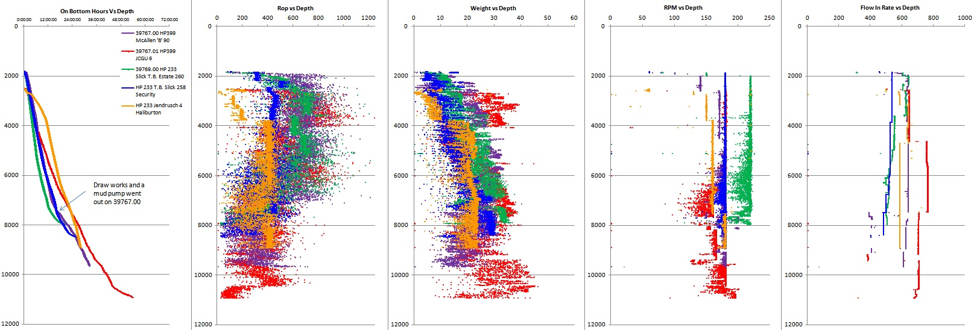
All South Texas 2017 runs with offsets

Slide 12
2017 South Texas Summary
  This 8-3/4” 619-SR design is too aggressive for this application
  The design could not handle the transitions from sand to shale and vice-versa
  Move design to obsolete
  Re-design the bit to be a 616-XR

